Slide 1
Inheritance

Slide 2
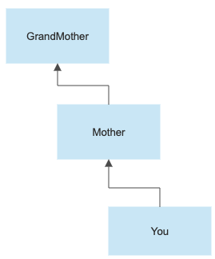
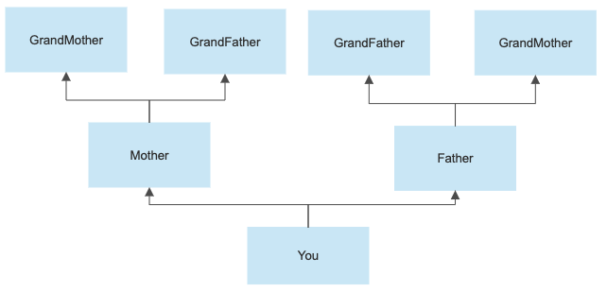
Inheritance
Parent to child relationships
Inheritance.
Personality traits.
Python inheritance
Parent class / Super class.
Child class / Sub class.

Slide 3
Inheritance
Like any other OOP languages, Python also supports the concept of class inheritance.
Inheritance allows us to create a new class from an existing class.
The new class that is created is known as subclass (child or derived class) and the existing class from which the child class is derived is known as superclass (parent or base class).

Slide 4
Inheritance
It is a mechanism that allows you to create a hierarchy of classes that share a set of properties and methods by deriving a class from another class.
Inheritance is the capability of one class to derive or inherit the properties from another class.

Slide 5
Inheritance
Inheritance is ’is-a’ relationship. Example:
Car is a Vehicle
Apple is a Fruit
Cat is an Animal
Give Daily Life Examples?

Slide 6
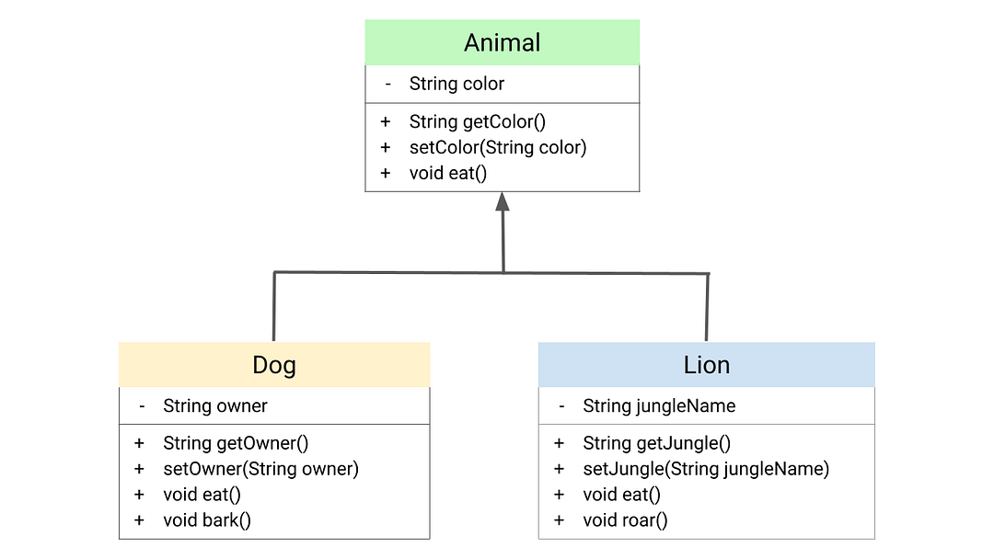
UML

Slide 7
Subclasses
A class can extend the definition of another class
Allows use (or extension ) of methods and attributes already defined in the previous one.
New class: subclass. Original: parent, ancestor or superclass
To define a subclass, put the name of the superclass in parentheses after the subclass’s name on the first line of the definition. Class Cs_student(student):
Python has no ‘extends’ keyword like Java.
Multiple inheritance is supported.

Slide 8
Python Inheritance Syntax
# define a superclass
class super_class:
# attributes and method definition
# inheritance
class sub_class(super_class):
# attributes and method of super_class
# attributes and method of sub_class

Slide 9
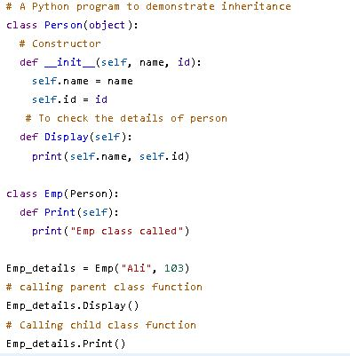
Example:1

Slide 10

Example: 1

Slide 11
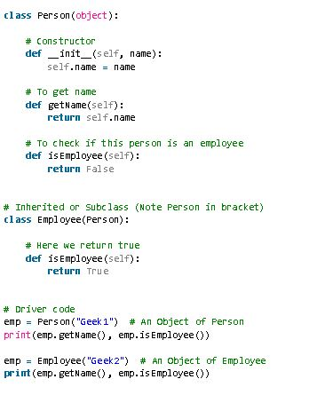
Example:2

Slide 12

Example:2

Slide 13
Redefining Methods
To redefine a method of the parent class, include a new definition using the same name in the subclass.
The old code won’t get executed.
To execute the method in the parent class in addition to new code for some method, explicitly call the parent’s version of the method.
parentClass.methodName(self, a, b, c)

Slide 14
Extending __init__
Same as for redefining any other method…
Commonly, the ancestor’s __init__ method is executed in addition to new commands.
You’ll often see something like this in the __init__ method of subclasses:
parentClass.__init__(self, x, y) where parentClass is the name of the parent’s class.

Slide 15
Definition of a class extending student
Class Student: “A class representing a student.”
def __init__(self,n,a): self.full_name = n self.age = a
def get_age(self): return self.age
Class Cs_student (student): “A class extending student.” def __init__(self,n,a,s): Student.__init__(self,n,a) #Call __init__ for student
self.section_num = s def get_age(): #Redefines get_age method entirely print “Age: ” + str(self.age)

Slide 16
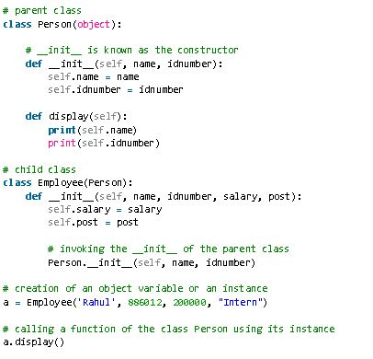
Example:3

Slide 17

Example:3

Slide 18
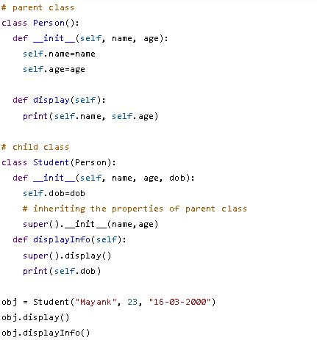
Example:4

Slide 19

Example:4

Slide 20
Benefits of inheritance are:
It represents real-world relationships well.
It provides the reusability of a code. We don’t have to write the same code again and again. Also, it allows us to add more features to a class without modifying it.
It is transitive in nature, which means that if class B inherits from another class A, then all the subclasses of B would automatically inherit from class A.
Inheritance offers a simple, understandable model structure.
Less development and maintenance expenses result from an inheritance.

